Slide 1


Amazon Sales Data Analysis Report

Slide 2
Objective:
Sales management has gained Importance to meet increasing competition and the need for improved methods of distribution to reduce cost and to increase profits. Sales management today is the most important function in a commercial and business enterprise.

Slide 3

Problem Statement:
Develop a Report by Extracting -Transforming-Loading of data which contains Sales trend with respect to Yearly-wise, Month-wise, Yearly_month- wise and find Some relationships through data to understand and Analyze the Facts.

Slide 4
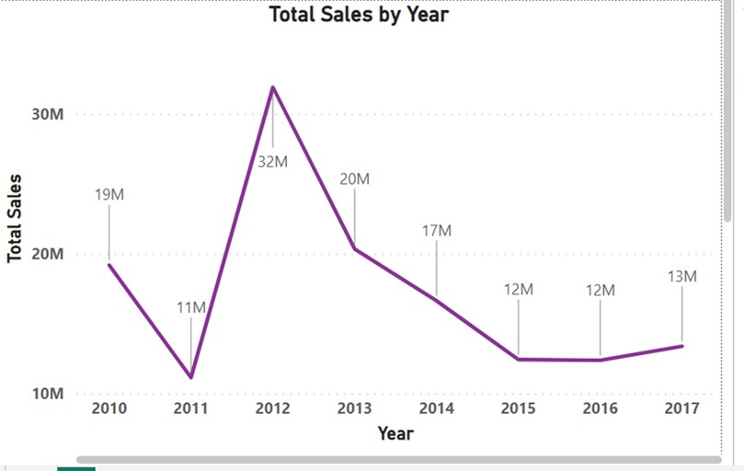

Total Sales
137.35M
Total Profit
44.17M
Avg profit margin
32.16
Avg unit price
276.76

Slide 5
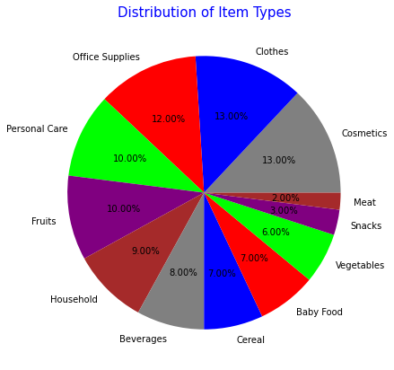
Item type of product sold revenue: >The Cosmetics and Clothes are the products with highest sales from all products followed by Office Supplies. > The Meat and Snacks are the products with lowest sales

Slide 6
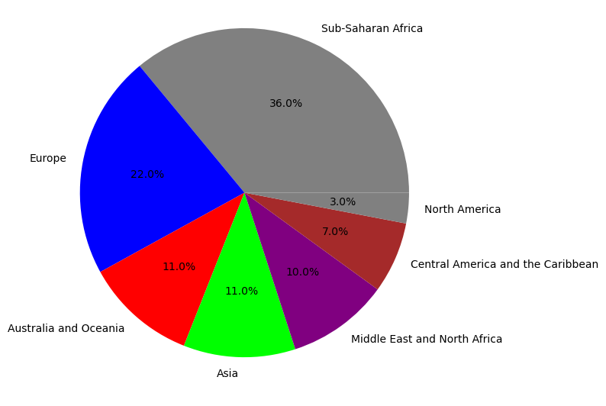
Revenue Categorized By Region
>As we have seen more revenue is generated from the region Sub-Saharan Africa followed by Europe.
>As we have seen more revenue is generated from the Country Djibouti at 6M.

Slide 7
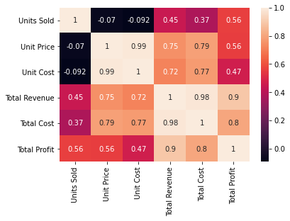

Slide 8
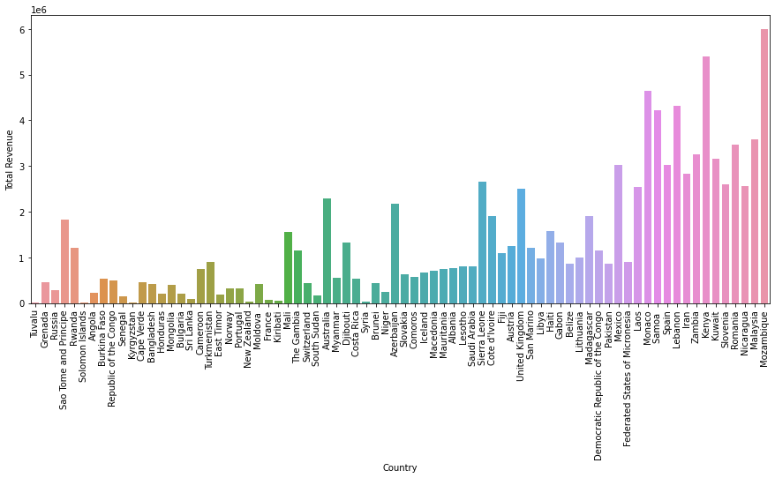

Slide 9
Conclusion:
2012 had the highest Revenue at 31.89.M, followed by 2013 at 20.33M and 2010 at 19.18M.
Cosmetic products are very popular among people of Europe and these products generated the highest profit of all items. So, it is advisable to create some marketing campaigns promoting Cosmetic products.
The Cosmetics& Clothes are the highest selling products followed by Office supplies in domestic and international markets.
. If we observe the monthly insights from 2010 to 2017, the sales are at their peak in February,April,May,July&October and are low in March, August & December. Amazon can come up with some good discounts and offers to generate high revenue.

Slide 10
Thank you

